Slide 2

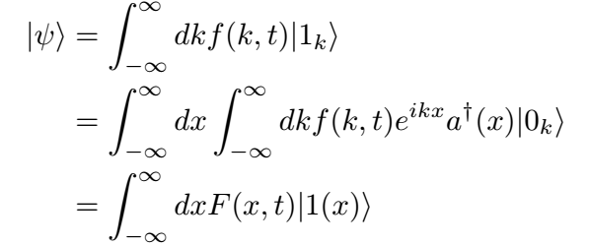
The wavefunction for a photon:
Fourier transform

Slide 3
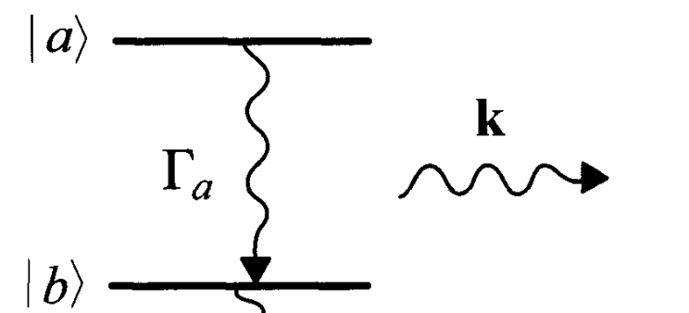
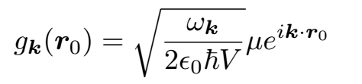


wavepacket from spontaneous decay (1D)

Slide 4
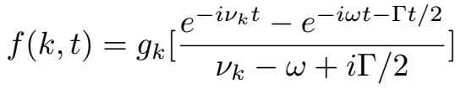
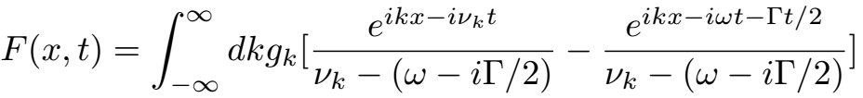
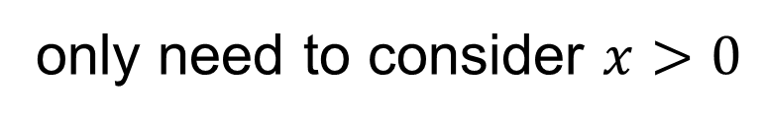


Wigner-Weisskopf approximation:
const
decay
steady state
$$+x$$
$$F\left(x,t\right)=F(−x,t)$$
atom
field point
only need to consider $x>0$

Slide 5
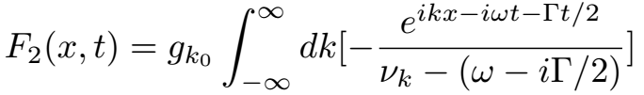
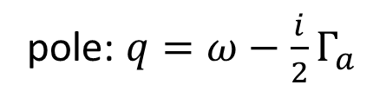
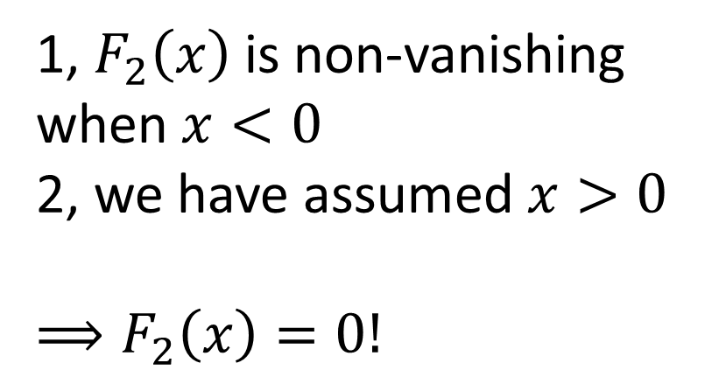
Fourier transform of the second term:
1, $F_{2}\left(x\right)$ is non-vanishing when $x<0$
2, we have assumed $x>0$
$$⟹F_{2}\left(x\right)=0!$$
pole: $q=ω−\frac{i}{2}Γ_{a}$

Slide 6
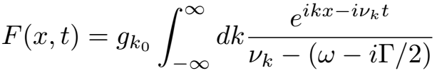

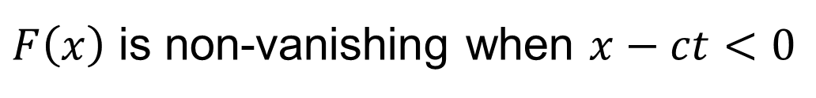
Fourier transform of the first term:
outgoing wave
incoming wave
$F\left(x\right)$ is non-vanishing when $x−ct<0$

Slide 7
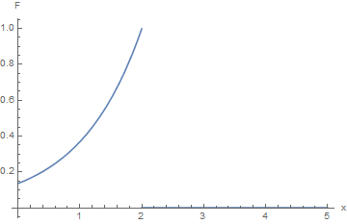

$$x=ct$$

Slide 9
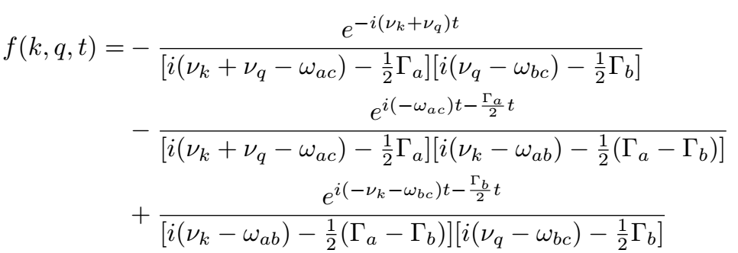
steady state
decay from |a>
decay from |b>

Slide 10
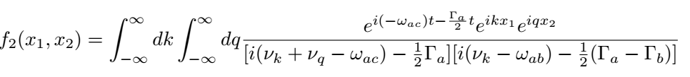
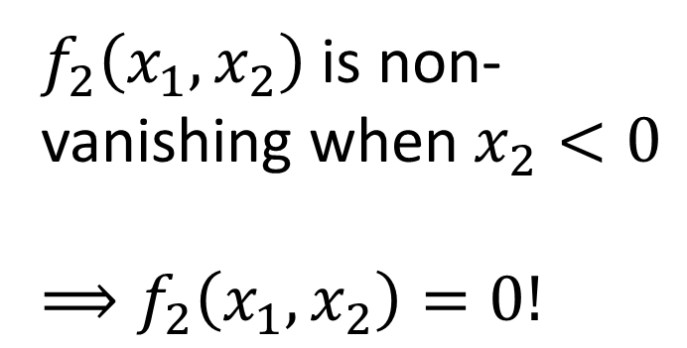
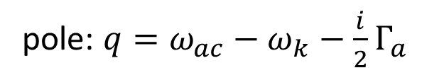
Fourier transform of the second term:
pole: $q=ω_{ac}−ω_{k}−\frac{i}{2}Γ_{a}$
$f_{2}\left(x_{1},x_{2}\right)$ is non-vanishing when $x_{2}<0$
$$⟹f_{2}\left(x_{1},x_{2}\right)=0!$$

Slide 11
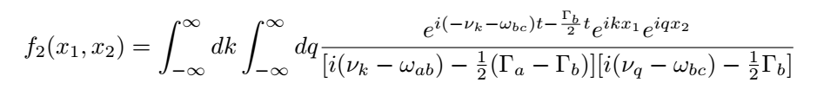
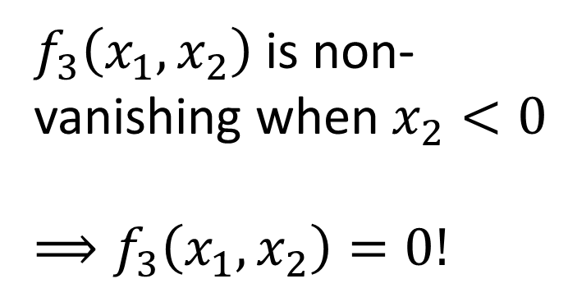
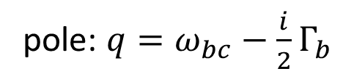
Fourier transform of the third term:
pole: $q=ω_{bc}−\frac{i}{2}Γ_{b}$
$f_{3}\left(x_{1},x_{2}\right)$ is non-vanishing when $x_{2}<0$
$$⟹f_{3}\left(x_{1},x_{2}\right)=0!$$

Slide 12
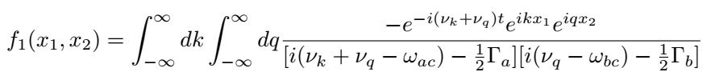
Fourier transform of the first term:

